Slide 1
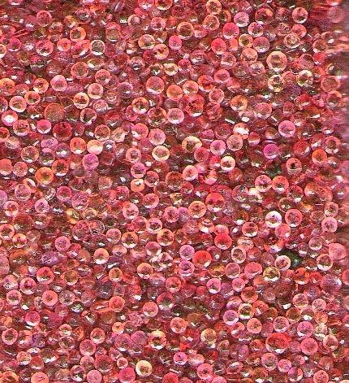
Object-oriented Programming with Ruby
Robert Batzinger
CSCI A-201
Spring 2009

Slide 2
Exploring with Ruby:
Useful classes to examine the world around us

Slide 3
Topics to be covered
Shell commands
Web pages
XML Files
SQL databases
Comma-separated files
Win32OLE

Slide 4
Communicating with the command shell
Pipe
Capturing STDOUT
Allows for bi-directional communications between the Ruby program and the shell command
Typical usage
pipe = IO.popen("sort","w+")
pipe.puts "Zebras"
pipe.puts "Yams"
pipe.puts "X-rays"
pipe.close_write
puts pipe.readlines
Merely captures the output of the shell command
Typical usage:
version = `ruby –v`

Slide 5
Connecting to the world-wide web
Basic steps
Build the URL
Load the webpage
Parse the information

Slide 6
Picking up text from internet
require 'net/http'
url = 'http://www.whitehouse.gov/robots.txt'
txt = Net::HTTP.get_response(URI.parse(url)).body
puts txt

Slide 7
Output of the contents
User-agent: *
Disallow: /includes/
Disallow: /search/
Disallow: /omb/search/

Slide 8
Information from a XML file
Basic steps:
Open the XML file
Parse the containers
Extract attributes of selected objects

Slide 9
Typical XML file
<CATALOG>
<PLANT>
<COMMON>Bloodroot</COMMON>
<BOTANICAL>Sanguinaria canadensis</BOTANICAL>
<LIGHT>Mostly Shady</LIGHT>
<PRICE>$2.44</PRICE>
</PLANT>
<PLANT>
<COMMON>Columbine</COMMON>
<BOTANICAL>Aquilegia canadensis</BOTANICAL>
<LIGHT>Mostly Shady</LIGHT>
<PRICE>$9.37</PRICE>
</PLANT>
</CATALOG>

Slide 10
Extraction of plant names
require "rexml/document"
file = File.new( "mydoc.xml" )
doc = REXML::Document.new file
doc.elements.each(‘CATALOG/PLANT') do |item|
puts "\n\n"
puts item.elements[‘COMMON']
end

Slide 11
Output
Bloodroot
Columbine

Slide 12
Combining http and xml together
require 'net/http'
require 'rexml/document'
url = 'http://feeds.nytimes.com/nyt/rss/US'
xml_data = Net::HTTP.get_response(URI.parse(url)).body
doc = REXML::Document.new(xml_data)
doc.elements.each('rss/channel/item') do |item|
puts "\n\n"
puts item.elements['title']
puts item.elements['pubDate'].text
end

Slide 13
Information from SQL databases
Steps:
Establish a connection with a SQL database
Develop an SQL query
Submit the SQL query to the database
Parse the results
Close the connection

Slide 14
SQL Query
require 'sqlite3'
db = SQLite3::Database.new( "cities.db" )
db.results_as_hash = true
db.execute(
"select * from cities where pop > :value",
"value" => 100000) do |row|
print row['city']
print ": "
puts row['pop']
end

Slide 15
Results
Evansville city:126272
Fort Wayne city: 173072
Gary city: 116646
Indianapolis city (outskirts): 731327
South Bend city: 105511

Slide 16
SQL QUERY with a hash
require 'sqlite3'
db = SQLite3::Database.new( "cities.db" )
db.results_as_hash = true
db.execute("select * from cities where pop > :value",
"value" => 100000) do |row|
print row['city']
print ": "
puts row['pop']
end

Slide 17
Results
South Bend city: 105511

Slide 18
Comma-separated files
Steps
Open the file
Parse the fields

Slide 19
Sample CSV
psmith01,CLASS2,Paul Smith smehta,CLASS2,Smeeta Mehta mrsjohns,ADMIN,Mrs R Johns
psmith02,CLASS2,Peter Smith scohen,CLASS3,Saul Cohen
swright,CLASS3,Shaun Wright
amarkov,CLASS3,Anya Markov

Slide 20
Extraction
require "csv"
users = CSV.read("users.csv")
failed = users.find_all do |u|
u[1]== "CLASS2"
end
failed.each do |u|
puts u[0]
end

Slide 21
Output
psmith01
smehta
psmith02

Slide 22
Win32OLE
Steps
Execute the target application
Transmit keystrokes
Navigation / Display / Storage

Slide 23
Sample Win32OLE
require 'win32ole'
ie = WIN32OLE.new('InternetExplorer.Application')
ie.Visible = 1
['http://www.google.com',
'http://www.iusb.edu',
'http://www.indiana.edu'].each { |url|
ie.navigate url
sleep 5
}
ie.quit

Slide 24
Navigating an Excel worksheet
require 'win32ole'
excel = WIN32OLE.new('excel.application')
excel.visible = true
workbook = excel.workbooks.add
excel.range('A1').value = 'Counts'
excel.range('A10').value = "Sum"
excel.range('A11').value = "Average"
excel.range('A12').value = "Std Dev"
excel.range('B1').value = 32
sleep 1.0
excel.range('a1:a9').Interior['ColorIndex'] = 36
excel.range('a10:a12').Interior['ColorIndex'] = 24
excel.range('b1:b9').Interior['ColorIndex'] = 19
excel.range('b10:b12').Interior['ColorIndex'] = 34
sleep 1.0
excel.range('B10').value = "=sum(B1:B9)"
excel.range('B11').value = "=average(B1:B9)"
excel.range('B12').value = "=stdev(B1:B9)"
sleep 1.0
excel.range('B2').value = 23;
excel.range('B3').value = 17;
excel.range('B4').value = 11;
excel.range('B5').value = 35;
excel.range('B6').value = 52;
excel.range('B7').value = 73;
excel.range('B8').value = 21;
excel.range('B9').value = 45;
sleep 1.0
workbook.saveas('c:\\a201\\test2.csv')
workbook.close
excel.Quit()

Slide 25
おわり The end

